Slide 1
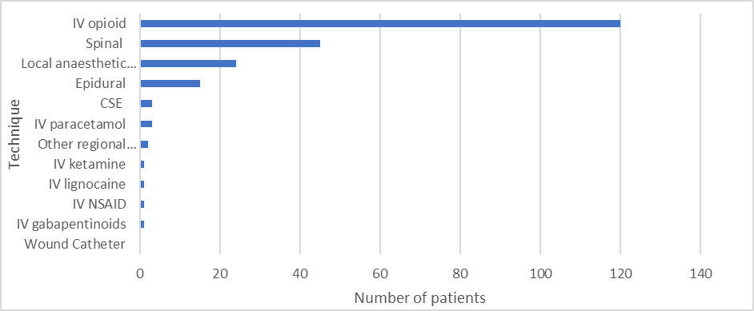
Using local PQIP data in the development of a regional bowel cancer quality improvement programme
Authors C Thomas ¹ E Gill ¹, S Alderson ², H Rossington ^{2,3}, S Howell ^{1,2}.
Institutions 1. Leeds Teaching Hospitals NHS Trust, 2. University of Leeds, 3. Leeds Institute of Data and Analytics.
Introduction The Yorkshire Cancer Research Bowel Cancer Improvement Programme (YCR BCIP) ¹ aims to reduce variation and improve outcomes for patients with bowel cancer across the region. Persistent postoperative pain is a leading cause of morbidity in survivors of cancer surgery ². There is however concern about the use of opioids ³ and a recent international consensus statement has been published on the prevention of perioperative opioid-related harm ⁴. Regional quality improvement work as part of the new YCR BCIP perioperative workstream has been launched using single-centre PQIP perioperative opioid data presented at Anaesthesia Research 2020. We organised a YCR BCIP opioid engagement event in March 2021 to define local practices around perioperative opioid use. Caldicott approval has been granted for the use of local data.
Conclusion PQIP data shows that at our site, over 40% of patients undergoing surgery for colorectal cancer were discharged with a new opioid prescription. In 1/3 of cases, opioid sparing adjuncts were not administered intraoperatively. We demonstrate effective use of PQIP data which has been used to both review practice in our Trust and to promote the use of local PQIP datasets at other sites. This has provided a focus for discussion and sharing of materials e.g. analgesia pathways and patient-facing information. Regional collaboration to align practice around opioid-sparing techniques and opioid use on discharge has been welcomed. This is a springboard for further multi-disciplinary engagement and regional data collection; a regional sprint audit involving site and patient data is currently underway to provide more detail on the wider perioperative management of this patient group.
Figure 1. Intraoperative use of opioid-sparing analgesia techniques
118 patients were discharged. 41% (n=48) were discharged with a new opioid prescription. 48.6% (n=36) or 48.6%) who received an opioid-sparing adjunct intraoperatively were discharged with an opioid prescription. 32.6% (n=15) who did not receive an opioid-sparing adjunct intraoperatively were discharged with an opioid prescription.
There was good attendance at the opioid engagement event with representation from ten of the fourteen regional bowel cancer MDTs including anaesthetists, colorectal surgeons and clinical pain nurse specialists (Table 1).
Methods A retrospective cross-sectional observational study was undertaken. PQIP data collected between September 2018 and March 2020 were reviewed. All patients undergoing operations for suspected or proven colorectal cancer were included. Data on the use of intraoperative neuraxial techniques, local anaesthetic infiltration, regional anaesthesia techniques, IV paracetamol, gabapentinoids, ketamine, NSAIDS and lignocaine were analysed. Opioid prescriptions at discharge were also reviewed. Analysis was conducted using Microsoft Excel. An online perioperative opioid engagement event was organised by the YCR BCIP group (which comprises clinicians and academics) to promote regional discussion and standardisation of practice.
Acknowledgements/ sources of funding We thank the LTHT surgical and anaesthetic research nurse teams for their work on the PQIP study. Yorkshire Cancer Research funding has been awarded to the YCR BCIP project, grant reference L394.
References
Yorkshire Cancer Research Bowel Cancer Improvement Programme (leeds.ac.uk)
Brown M, Ramirez J, Farquhar-Smith P. Pain in cancer survivors. Br J Pain. 2014; 8 (4):139-53
Degenhardt L, Grebely J, Stone J et al. Global patterns of opioid use and dependence; harms to populations, interventions and future directions. The Lancet. 2019; 394: 1560-79
Levy N, Quinlan J, El-Boghdadly K et al. An international multidisciplinary consensus statement on the prevention of opioid-related harm in adult surgical patients. Anaesthesia. 2021; 76: 520-36.
Professional group | Number in attendance
Consultant anaesthetists | 21
Trainee anaesthetists | 6
Surgeons | 4
Perioperative medicine practitioner | 1
Pain nurse specialists | 5
Results Data were analysed for 120 patients undergoing major or complex-major operations for colorectal cancer. 62% (n=74) patients received at least one intraoperative opioid-sparing adjunct. Neuraxial techniques were the most commonly used, with 53% (n =64) patients receiving a neuraxial block.
Table 1. Multi-disciplinary engagement

